Slide 1

UNIVERSITY INSTITUTE OF ENGINEERING
COMPUTER SCIENCE ENGINEERING
Computer Vision (CST-422)
Prepared By : Payal Thakur(E12720)
Topic: Labeling your Images for Machine Learning
DISCOVER . LEARN . EMPOWER

Slide 2
Image Labeling
Image labeling is a type of data labeling where the goal is to add meaningful information to images.
The task in general is to identify certain features or objects in an image, and then to use this information to select said objects in an image, to classify the image according to the presence of these features.
In other words, it’s when you annotate certain objects or features in an image.
These labels teach a computer vision model how to identify a particular object.
For example, in a series of high-angle images of a city, you could annotate all the skyscrapers. These labels help a model determine what a skyscraper is.

Slide 3
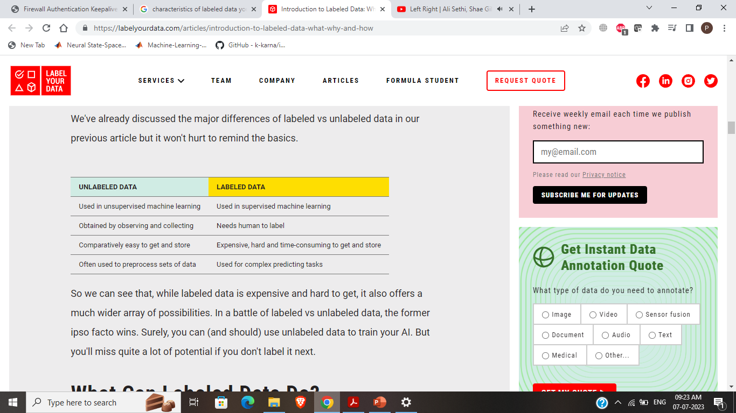

Slide 4
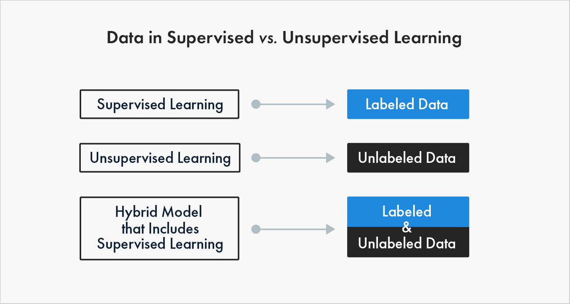

Slide 5
Image Labeling
Image annotation is used to create datasets with different objects for computer vision models, which are split into training sets — for initial model training — and test/validation sets — to evaluate model performance.
Data scientists use the dataset to train and evaluate their model.
Then the model can automatically assign labels to unlabeled data.
By using the right image labeling strategy, you can create a high-quality dataset that will help a model better learn how to identify objects.
Labeling images is a dynamic process which machine learning engineers are continuously adapting and improving upon.

Slide 6
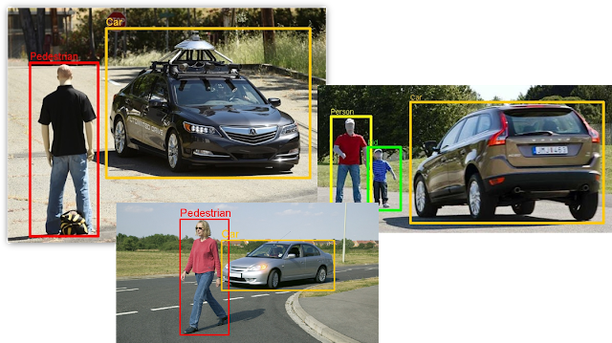

Slide 7
How to Label Image Data for Machine Learning
1. Define which kind of data you need for model training
The type of data labeling task you will do will depend on that.
For example, in some cases you might need sets of images representing certain categories (image classification task), in other cases you might need images with certain types of objects identified and selected (object detection task).
2. Define the characteristics of labeled data your model needs
For an image classification task, you need to define classes.
For object detection tasks, the rules of markup: do you need precise selection via polygons, or is it enough to use bounding boxes?

Slide 8
How to Label Image Data for Machine Learning
3. Decide how much labeled data of each type you need
Before collecting and labeling data, you need to understand how much of each type of data you need to train a balanced and unbiased ML model.
You wouldn't want to skew your model's performance due to imbalanced training data.
4. Choose the optimal way to label training data
In general, there are a few ways: human data labeling or automation.
Human labeling is more time consuming and expensive, but tends to be more reliable.
If you decide you need human input, there is in-house labeling, outsourcing, and crowdsourcing

Slide 9
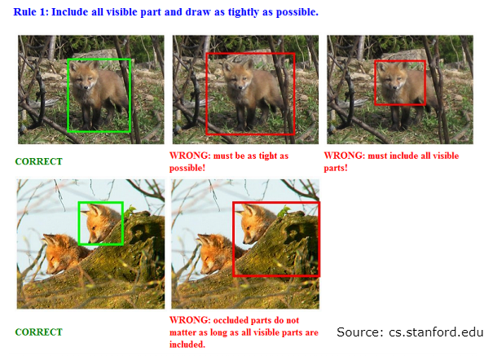

Slide 10
How to Label Image Data for Machine Learning
5. Decompose the labeling task
If you decide to employ human data labeling to ensure high-quality results, you'll need to break your image labeling task down into steps that are clear enough for anyone to handle.
To ensure optimal labeling, break your task down into parts by replacing one large problem with a series of smaller, separate problems that are easier to solve.
6. Write clear instructions
The more straightforward and clear your labeling instructions are, the more reliable the whole process will be.
Oftentimes, things that seem obvious to you might not be clear to everyone else.
Write concise and comprehensive instructions, provide examples, and foresee common mistakes.

Slide 11
How to Label Image Data for Machine Learning
7. Set up quality control
Think in advance about what you will do to ensure the quality of labeled data, preferably automatically, without the need to check the results yourself.
This usually means you need to create a pipeline: a series of labeling and verification steps for your image labeling process.
For example, divide your object detection task between three groups of people: the first person defines whether the desired object is present on an image, the second person selects the said object, and the third person checks if the object has been selected correctly.

Slide 12
Methods Used In Image Labeling
Image annotation sets a standard that computer vision algorithms try to learn from. Therefore, accurate labeling is essential in training neural networks. There are three methods for image labeling: manual, semi-automated, and synthetic.
Manual image annotation
This process involves manually defining labels for an entire image or drawing regions in an image and adding textual descriptions for each region. There is a special kind of computer vision annotation tool that allow operators to rotate through multiple images, draw regions (bounding boxes or polygons) on an image and assign labels, and save this data to a standardized format that can be used for data training.

Slide 13
Methods Used In Image Labeling
However, an in-house approach to manual image annotation has some drawbacks: labels can be inconsistent when multiple annotators are involved, and it’s time consuming, costly, and difficult to scale for large datasets. To ensure consistency, annotators must be provided with clear instructions and consideration needs to be given to quality control of the labeling.

Slide 14
Methods Used In Image Labeling
Semi-automated image annotations
An automated image annotation tool can help manual annotators by attempting to detect object boundaries in an image and providing a starting point for the annotator.
The algorithms of image annotation software are not 100% accurate, but they can save time for human annotators by providing at least a partial map of objects in the image.

Slide 15
Methods Used In Image Labeling
Synthetic image labeling
As an alternative to manual image annotation, synthetic image labeling is an accurate and cost-effective technique.
It involves automatically generating images that are similar to real-life objects or human faces.
The main benefit of synthetic images is that labels are known in advance.

Slide 16
How to Label Images via Crowdsourcing
Crowdsourcing refers to a specific process of labeling data that employs many annotators who have signed up on a particular platform. Simply put, teams working with artificial intelligence post unlabeled data and labeling tasks, and people choose and complete tasks they are interested in.
The main challenge lies in correctly formulating a small, simple task. You need a specialist to correctly configure the data annotation pipeline and quality control. Then you can scale annotation and get large volumes of marked-up data quickly, efficiently, and inexpensively.
Overlap is the key to crowdsourcing and is defined as the number of annotators who should complete each task in a pool. Most commonly, it’s set to three.

Slide 17
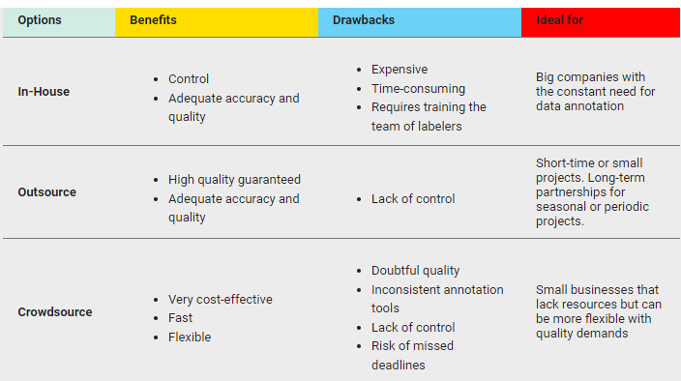

Slide 18
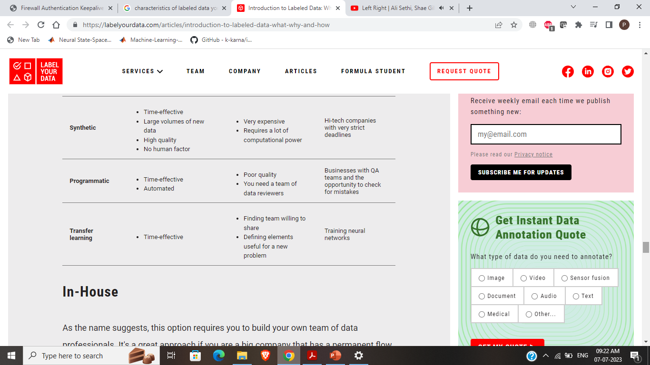

Slide 19
What does the typical image annotation process look like?
Step 1: Decompose the task and classify content
In any image classification task, start with the main question you want to ask. If it’s complex, you may want to break the job down into subtasks. After you’ve defined the question, ask yourself what classes you expect — which can help you define the answers, prepare a task interface, and write instructions for annotators.
Example: If you want to create a dataset with marked-up photos of cars, you can assign three consecutive tasks to three groups of annotators. The first task would be to select all the images showing a car, the second to highlight that required object (or multiple objects) with a polygon, and the third to check that the car is indeed highlighted correctly.

Slide 20
What does the typical image annotation process look like?
Step 2: Prepare instructions for annotators
The more complete and clear your instructions are for annotators, the better labeling quality you will get. Mix in some control tasks with the real ones. That way, you can compare annotator answers with the answers to the control tasks to get an idea of labeling accuracy.
To improve your instructions, you can run labeling for a small part of your dataset without control tasks first. Read through the results. This will reveal the most common errors and identify cases the instructions don’t cover.
Example: A potential error in the scenario mentioned above is if toy cars are also included in the images. This leads to the question: should toy cars be counted or not?

Slide 21
What does the typical image annotation process look like?
Step 3: Direct markup
The task interface defines what the job looks like for the annotators, and the logic they follow to process their responses. If it’s simple and clean, they can work faster and on different devices. Adding automatic verifications improves labeling quality.

Slide 22
Types of image labeling
Image classification
Image classification algorithms receive images as an input and automatically classify them into one of several labels (also known as classes). Machine learning models must learn to recognize such objects in the images themselves. To create a training dataset for image classification, you need to manually review images and annotate them with labels used by the algorithm.
How to do it: Take a look at an image and see what’s being shown – for example, a cat or a dog. Then choose which class the object in the image belongs to.

Slide 23
Types of image labeling
Image comparison (side-by-side)
Image comparison is used to determine the opinion of a large group of people — what they like, what’s more convenient, and so on. For example, understanding which images in advertising banners people prefer, or which illustration prompts them to click on an article.
How to do it: When comparing two images, choose the one that is more suited to the given context, for example, when choosing which interface design is superior.

Slide 24
Types of image labeling
Object detection
An object detection algorithm detects an object in an image and its location in the image frame. The location is marked with different shapes. For example, facial recognition dots are used for models in facial recognition systems. Bounding box — the smallest rectangle that contains the entire object in the image — can be used to define the location of objects.
How to do it: You may be given the task of finding and highlighting an object in an image. For example, traffic lights, pedestrians, or cars, which can be used to train models in self-driving cars. A machine learning engineer selects a shape (rectangle, polygon, or other) that is best suited to the given model. Then the engineer assigns a specific task to you (the annotator) such as “highlight all the traffic lights with rectangles”.

Slide 25
Types of image labeling
Text recognition from images
Text recognition for images is used for various text recognition systems — think using your camera app to hover over text written in a foreign language and getting a translation.
How to do it: Generally, these tasks include images that contain text (such images are selected in advance). Your task is to read the text and type what is written there.

Slide 26
References:-
Books:-
"Introduction to Computer Vision" by David Forsyth and Jean Ponce. Chapter 6: Features and Descriptors provides an in-depth explanation of feature detection, extraction, and matching algorithms.
Computer Vision: Algorithms and Applications" by Richard Szeliski. Chapter 4: Image Features covers various feature detection, extraction, and matching techniques.
Video Links
"Feature Detection and Description" by Stanford University - Computer Vision (CS231n). Available on YouTube: https://www.youtube.com/watch?v=H-HVZJ7kGI0
"Feature Matching and Homography" by University of Washington - Computer Vision (CSE 576). Available on YouTube: https://www.youtube.com/watch?v=uvSCXyYpG9k
"Introduction to Feature Detection and Matching" by OpenCV. Available on YouTube: https://www.youtube.com/watch?v=AWoG8vdw4pA

Slide 27
THANK YOU
For queries
Email: payal.e12720@cumail.in

